Slide 1
DPICS Dancing
Beth Troutman
Emma Girard
Kami Guzman

Slide 2
Thanks
Thanks to Marta Shinn and Arlene Turner whose presentation at the 2014 Iowa PCIT Tune-Up inspired me to incorporate more active play into my life and PCIT training.

Slide 3
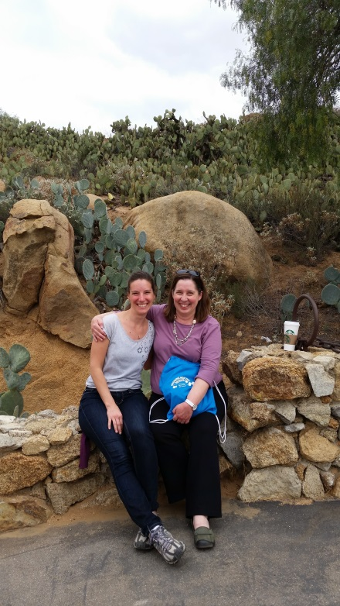
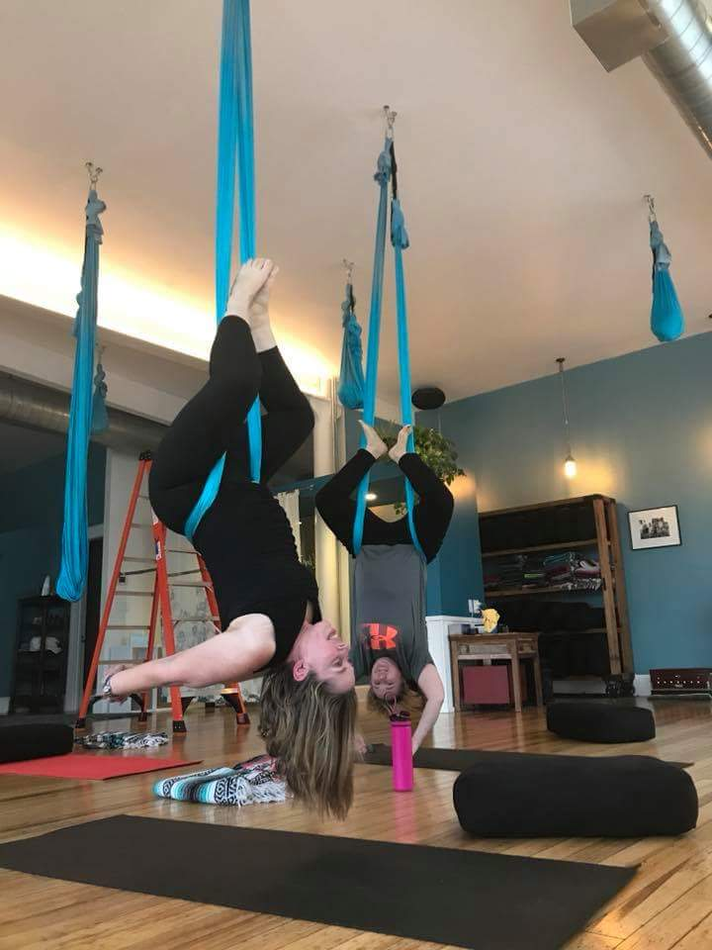
Thanks
Thanks to Emma and Kami for their willingness to join me in another active play adventure.

Slide 4
Objectives At the conclusion of the symposium, participants will:
Experience the benefits of incorporating fun movement activities into their daily life.
Be able to simultaneously dance and code DPICS.

Slide 5
Caveat #1
Most PCIT therapists don’t actually dance while they are coding.

Slide 6
Caveat #2
Most parents don’t sing while you are coding.
If a parent sings to their child while you are doing DPICS coding, you would not typically code the singing.
The EXCEPTION is when the parent uses the “Clean-Up Song” as a directive for the child to clean up.

Slide 7
Some verbalizations are not coded. I will skip these when we’re dancing.

Slide 8
Step 1 – Now we dance
https://www.youtube.com/watch?v=QHZR9SA5pOg

Slide 9
Step 2 – Code lyrics to song we danced to

Slide 10
Hint #1 for coding lyrics
Code the lyrics as though the person singing them is in an interaction with another person.

Slide 11
Hint #2 : Remember your DPICS Priority Order
Negative Talk (NTA)
Direct Command (DC)
Indirect Command (IC)
Labeled Praise (LP)
Unlabeled Praise (UP)
Question (QU)
Reflection (RF)
Behavior Description (BD)
Neutral Talk (TA)

Slide 12
Step 3 – Now we dance again and say the code for the lyrics while dancing.

Slide 13
DANCE Better When I’m Dancing Meghan Trainor
https://www.youtube.com/watch?v=t6PmB6tMBOc

Slide 14
DANCE Attention Charlie Puth
https://www.youtube.com/watch?v=39qcZKm9T1Y

Slide 15
DANCE Havana Camila Cabello
https://www.youtube.com/watch?v=kYoO_-BmXm0

Slide 16
DANCE I Will Survive Gloria Gaynor https://www.youtube.com/watch?v=IdJyofgzSJM

Slide 17
DANCE Move Up & Down Mademoiselle Luna
https://www.youtube.com/watch?v=t4zckEYxDyA&start_radio=1&list=RDt4zckEYxDyA

Slide 18
DANCE Brave Sara Bareilles and Jack Antonoff https://www.youtube.com/watch?v=QUQsqBqxoR4

Slide 19
DANCE Mom Meghan Trainor
https://www.youtube.com/watch?v=q-F3efxbXaE

Slide 20
The DPICS Dancers (minus Emma who took the picture)

