Slide 1
Parent-Child Interaction Therapy: A Family Based intervention for children with heariNG Differences
*DISCLOSURE STATEMENT
Elizabeth Adams, Ph.D.; Colleen Caverly, M.A. ; Lori Day, Ph.D.

Slide 2
Wellbeing of Parents/Families of Children with Hearing Differences
Disability-specific stressors lead to lower levels of parental wellbeing
Parents report:
Communication difficulties
Behavioral concerns
Lack of available information/services
Depression/Isolation
What are parents asking for?
Hintermair, 2006; Lederberg & Golbach, 2002;
Sarant & Gerrard, 2013; Quittner et al., 2010

Slide 3
Family-Centered Care
Buffer: Family-Centered Care
Families as experts, professionals as agents of support
Environmental context is considered
Practitioners work to meet families at their level, and to appreciate complexities of intersecting components
Components of Family-Centered Interventions
Parental Involvement
Addresses multiple concerns
Hodgetts et al., 2013; Kuo et al., 2012

Slide 4
Family-Centered Treatment
Barriers
Heterogeneous population
Results in misconstrued data/information, negative perceptions, limited awareness
Applied vs. Modified/Adapted interventions
Are we meeting the needs of the families (i.e., are the interventions truly family-centered)?
Treatment is generally one-dimensional
Contemporary treatment/interventions should utilize holistic lenses to address the intersection of concerns reported by families
Hintermair, 2006

Slide 5
Parent Involvement in Intervention
Interventions that facilitate parent engagement often result in improved development and outcomes
Language development
Behavior management
Parent-child relationship
Why is parent involvement critical?
Transfer of results from treatment to home
Parents create learning environments
Parents offer insight as to concerns that need to be addressed
Houston & Bradham, 2011

Slide 6
PCIT for Families of Children with Hearing Differences
PCIT as a language/behavior intervention for families who use spoken English
PCIT as a behavior intervention for families who use ASL

Slide 7
PCIT as a Language Intervention

Slide 8
PCIT – Modified for Language Intervention
Modified PCIT – Parent Coaching for language intervention
Parents are taught specific skills to utilize Indirect Language Stimulation:
Facilitative language techniques
Labeled Praise
Reflections
Expansion
Extension/Expatiation
Buildups and Breakdowns
Recast Sentences
Imitation
Description (Parallel-talk)
Information Description (Self-talk)
Enjoyment
CDI
Eyberg, Nelson, & Boggs, 2008; PCIT International

Slide 9
The Behavior / Language Connection
High rates of comorbidity exist between language delays and behavioral problems in children
71% of children seen clinically for externalizing behavior disorders are also suggested to have language deficits
Etiology unclear
Processing and language difficulties may result in inattentiveness, aggression, or social withdrawal
Behavioral difficulties may lead children to be less attentive to adults or able to access learning and language
Regardless of causal pathways, language delays put children at risk for adverse outcomes
Influence of parents requires examination into how to incorporate parents into treatment
Benner et al., 2002; Cohen, 2001
Notes:
Trim down

Slide 10
Characteristics of Parent Speech
Specific characteristics of parent speech are positively correlated with measures of children’s language development:
Questions and commands
Frequent use of directives and corrective statements correlate with delays in language
Parent behavior in free play
Most facilitative to language development
Parent focuses on same activity as the child
Engages the child in conversation by eliciting child verbal replies
Contingently responds to child speech
Dunn & Dunn, 1981; Hammill & Newcomer, 1988
Notes:
Trim down

Slide 11
PCIT for Children with Hearing Differences
PCIT has been shown to improve:
Oppositional behavior in children
Traditional implementation of PCIT
Language – specifically pragmatic language
Developmental play
Prosocial behavior
Increase positive interactions with parents
Improve parental interaction style by increasing:
Reflective listening
Physical proximity
Prosocial verbalizations
Parental locus of control
Decreasing criticism and negative talk
Decreasing parental distress
Eyberg, Nelson, & Boggs, 2008; PCIT International

Slide 12
Parent Skill Changes in River Pilot Study
8 River School Families
Pre-post language data and parent data collected

Slide 13
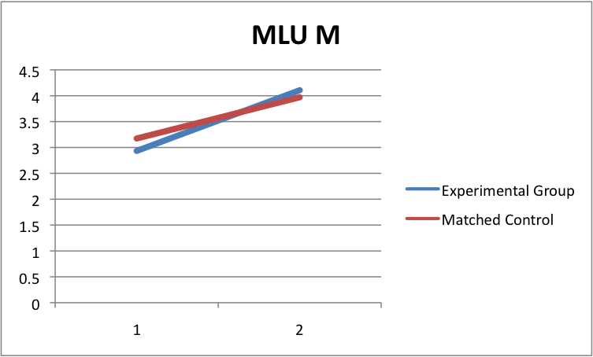
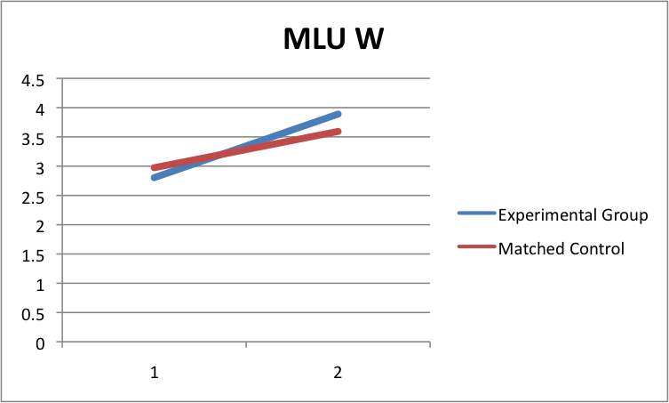
Mean Length Utterance - MLU
Effect Size: r=0.52 (large)
Effect size: r=0.44 (Medium)

Slide 14
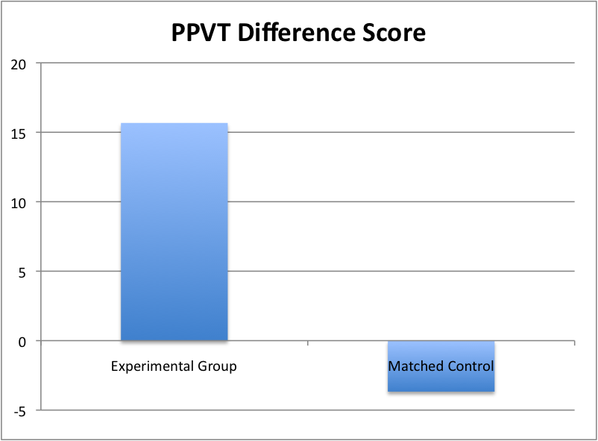
PPVT Change in Scores
Effect Size: r = 0.85 (large)

Slide 15
Change in Child Behavior - PDI
Results from paired-samples t-tests, with a Bonferroni correction, revealed that there was a statistically significant improvement in child behavior
(t(6) = 5.310, p = .002).

Slide 16
PCIT with Families who use ASL

Slide 17
PCIT in ASL
Is it feasible to do PCIT in American Sign Language?
Adapted PCIT manual following a general adaptation process
Piloting PCIT in ASL with a group of heterogeneous families
Preliminary data suggest that PCIT is effective with this population
Each family unique with regard to communication, learning style, family dynamics, and additional needs/considerations
Baumann et al., 2015

Slide 18
Rationale
Previous studies of effectiveness of PCIT with families who use sign language
Non-signing clinician
Use of interpreters
Complicated treatment modifications
Pure sampling using direct communication to eliminate confounds
Systematic generalization to assist other clinicians
Armstrong, David, & Goldberg, 2014; Shinn, 2013

Slide 19
Coding Considerations
Development of DPICS addendum for situations where English-based rules don’t apply
Tapping/hand waving
Ambiguous signed phrases
CAR CL:3(car moves to the left)
Non-manual markers
Ex: Eyebrow raise to indicate question
Mindfulness of gestures vs. signs
Video reliability checks on coaching

Slide 20
Coaching Considerations
In-room coaching
Movement throughout the room to be visible to family
Discrimination between who is talking to whom
Clear distinction between line feeding and other coaching statements
Length and timing of coaching statements

Slide 21
Implemented Modifications
CDI SESSIONS
CDI/PRIDE skills key terms
Ex: Labeled vs. Unlabeled Praise
Video “handout” of PRIDE skills
Extra PRIDE skill examples
Appropriate to ASL
PDI SESSIONS
Time-Out Verbatim in ASL
Video “handout”
Managing eye contact when giving a command
Coding commands
Ex: Tapping on shoulder/hand waving

Slide 22
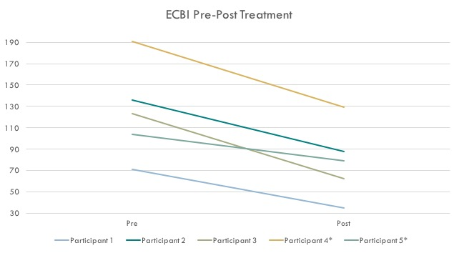
Preliminary Evidence: Child Behavior
* Indicates incomplete treatment

Slide 23
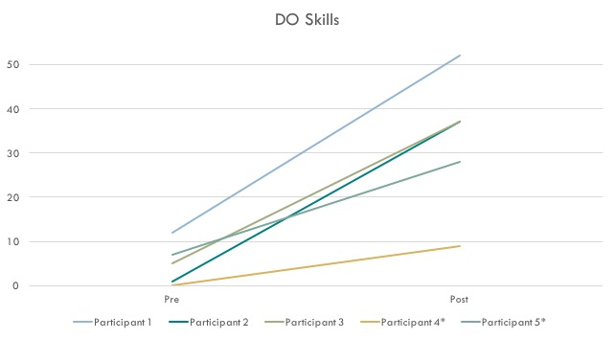
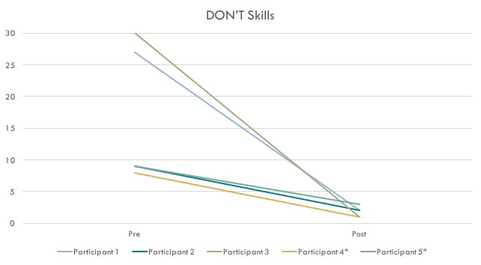
Preliminary Evidence: Parent Skills
* Indicates incomplete treatment

Slide 24
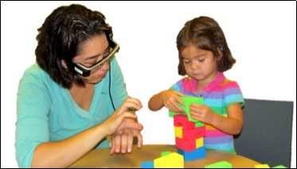
Ongoing/Future Research
Efficacy of proposed/implemented ASL modifications
ASL Translation of Parent Handouts
DPICS Addendum – ASL Coding
PCIT as a language intervention for parent-child dyads with weak shared communication
Feasibility of PCIT using head mount display technology
Coding reliability through utilization of interpreters

Slide 25
References
Armstrong, K., David, A., & Goldberg, K. (2014). Parent-Child Interaction Therapy With Deaf Parents and Their Hearing Child: A Case Study. Clinical Case Studies, 13(2), 115–127.
Baumann, A. a., Powell, B. J., Kohl, P. L., Tabak, R. G., Penalba, V., Proctor, E. K., Domenech-Rodriguez, M.M., & Cabassa, L. J. (2015). Cultural adaptation and implementation of evidence-based parent-training: A systematic review and critique of guiding evidence. Children and Youth Services Review, 53, 113–120.
Cohen, N.J. (2001). Language impairment and psychopathology in infants, children, and adolescents. Thousand Oaks, CA: Sage.
Dunn, L.W., & Dunn, L.M. (1981). Peabody Picture Vocabulary Test- Revised (Forms L and M). Circle Pines, MN: American Guidance Service.
Eyberg, S.M. (1999) PCIT Manual. Available on-line at www.PCIT.org [see PCIT Information and Material].
Eyberg, S.M., & Boggs, S.R. (1989). Parent training for oppositional-defiant preschoolers. In C. E. Schaefer & J. M. Briesmeister (Eds.), Handbook of parent-training: Parents as co-therapists for children’s behavior problems (pp 105-132). New York: John Wiley & Sons.
Hart, B., & Risley, T.R. (1995). Meaningful differences in the everyday experience of young American children. Baltimore: Paul H. Brookes Publishing Co.
Hintermair, M. (2006). Parental resources, parental stress, and socioemotional development of deaf and hard of hearing children. Journal of Deaf Studies and Deaf Education, 11(4), 493–513.
Hodgetts, S., Nicholas, D., Zwaigenbaum, L., & McConnell, D. (2013). Parents’ and professionals’ perceptions of family-centered care for children with autism spectrum disorder across service sectors. Social Science & Medicine, 96, 138-146.
Houston, K.T. & Bradham, T.S. (2011). Parent engagement in audiologic habilitation: Increasing positive outcomes for children with hearing loss. The ASHA Leader; July 05.
Hubbell, R. (1981). Children’s language disorders: An integrate approach. Englewood Cliffs, NJ: Prentice-Hall.
Kuo, D. Z., Houtrow, A. J., Arango, P., Kuhlthau, K. A., Simmons, J. M., & Neff, J. M. (2012). Family-centered care: Current applications and future directions in pediatric health care. Maternal and Child Health Journal, 16(2), 297-305.

Slide 26
References
Lacroix, V., Pomerleau, A., Malcuit, G., Seguin, R., & Lamarre, G. (2001). Cognitive and language development of children during the first three years of life with respect to maternal vocalizations and toys at home: Longitudinal study of a high-risk population. Canadian Journal of Behavioral Science, 33, 65-76.
Lederberg, A. R., & Golbach, T. (2002). Parenting stress and social support in hearing mothers of deaf and hearing children: A longitudinal study. Journal of Deaf Studies and Deaf Education, 7(4), 330–345.
Paul, R. (2001). Language disorders from infancy through adolescence and assessment and intervention. St. Louis, MO: Mosby, Inc.
Pressman, L., Pipp-Siegal, S., Yoshinaga-Itano, C., and Deas, A. (1999). The relation of sensitivity to child expressive language gain in deaf and hard-of-hearing children whose caregivers are hearing. Journal of Deaf Studies and Deaf Education, 4: 294-304.
Quittner, A. L., Barker, D. H., Cruz, I., Snell, C., Grimley, M. E., Botteri, M., & CDaCI Investigative Team. (2010). Parenting stress among parents of deaf and hearing children: Associations with language delays and behavior problems. Parenting: Science and Practice, 10, 136–155.
Quittner, A.L., Cruz, I., Barker, D.H., Tobey, E., Eisenberg, L.S., & John K. Niparko, J.K. (2013). Effects of maternal sensitivity and cognitive and linguistic stimulation on cochlear implant users' language development over four years. The Journal of Pediatrics, 162(2), 343-348.
Sarant, J., & Garrard, P. (2013). Parenting stress in parents of children with cochlear implants: Relationships among parent stress, child language, and unilateral verses bilateral implants. Journal of Deaf Studies and Deaf Education,19(1), 85–106.
Spencer, P.E., & Meadow-Orlans, K.P. (1996). Play, language, and maternal responsiveness: A longitudinal study of defa and hearing infants. Child Development, 67, 3176-3191.
Shinn, M. M. (2013). Parent-Child Interaction Therapy With a Deaf and Hard of Hearing Family. Clinical Case Studies, 12(6), 411–427.
Tempel, A.B., Wagner, S. M., & McNeil, C.B. (2008). Parent-Child Interaction Therapy and language facilitation: The role of parent-training on language development. Journal of Speech-Language Pathology & Applied Behavior Analysis, 3.2-3.3, 78-94.
Webster-Stratton, C., & Hammond, M. (1999). Marital conflict management skills, parenting style, and early-onset conduct problems: Processes and pathways. Journal of Child Psychology and Psychiatry, 40(6), 917-927.
Zaidman-Zait, A., & Most, T. (2005). Cochlear implants in children with hearing loss: Maternal expectations and impact on the family. Volta Review, 105, 129-150.

