Slide 1
Family Engagement:
Teaching Tools & Coaching in PCIT
Emma Girard, Psy.D.
Assistant Clinical Professor of Psychiatry
PCIT-International Certified Master Trainer
UC Davis PCIT Training Partner

Slide 2

PCIT Coaches Poll
How many times have you asked yourself:
Is my coaching translating to home?
What techniques can I use to build up caregiver skills?
Is there a handout for this?

Slide 3
Agenda & Goals
Improve clinical knowledge related to adult learning theory
Review and provide teaching tools during CDI to improve caregiver skill acquisition
Review and provide teaching tools during PDI to improve caregiver skill acquisition

Slide 4
What is Adult Learning Theory?
Andragogy:
“Methods or techniques used to teach adults” (Random House, Inc. 2018.)
Advanced work of Malcolm Knowles (1913-1997)
Notes:
Malcolm Knowles: American Educator

Slide 5
Knowles 4 ALT applied principles
Adults need to be involved in the planning and evaluation of their instruction
Experience (including mistakes) provides the basis for the learning activities
Adults are most interested in learning subjects that have immediate relevance and impact to their job or personal life
Adult learning is problem-centered rather than content-oriented (Kearsley, 2010)
https://elearningindustry.com/the-adult-learning-theory-andragogy-of-malcolm-knowles
Notes:
#4 problem-centered rather than content-oriented – OH NO… we have TEACH sessions that are content driven, are we tying in enough personal info related to client to make it relevant?

Slide 6
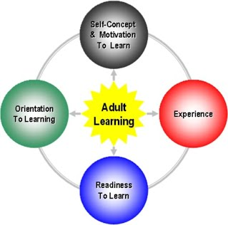
As a PCIT Coach…
Do we consider the needs of our caregivers and how to apply Adult Learning Theory?
Image Source:
http://leanlearning.wikispaces.com/instructional_design
Notes:
List various obstacles that interfere with each learning category.

Slide 7
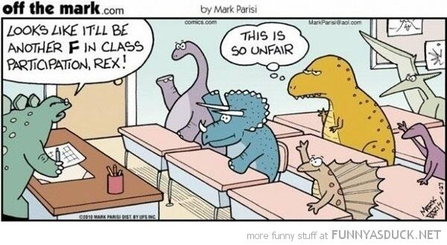
Adult Learning: Experience
Adults have a vast array of experiences and areas of interest to draw on as they learn
Notes:
as opposed to children who are in the process of gaining new experiences

Slide 8
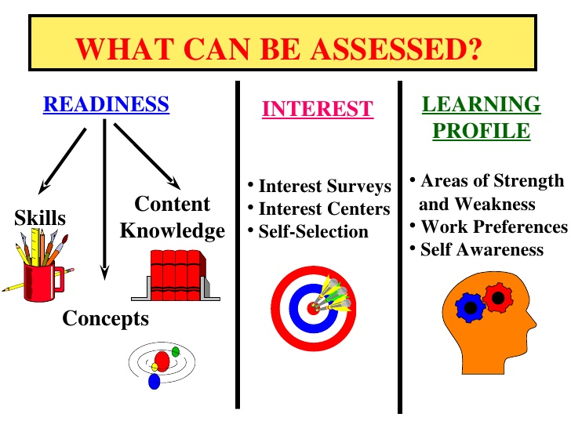
Readiness to Learn
Side Credit: Sholom Fried MS Ed, SBL, SDL (2010)

Slide 9
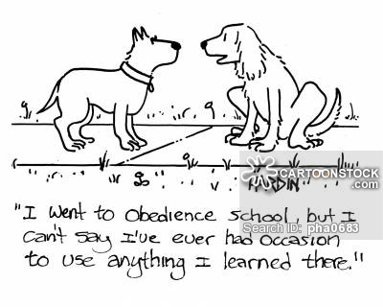
Orientation to Learning
Notes:
For adults: assumption that with maturity the motivation to learn becomes internal (Knowles 1984)

Slide 10
Self Concept & Motivation to Learn
Defined by Knowles as:
  With maturity comes moving from being a dependent personality to being a self-directed human being
    From subject-centeredness to problem centeredness
  Motivation related to parenting or to changing child behaviors?

Slide 11
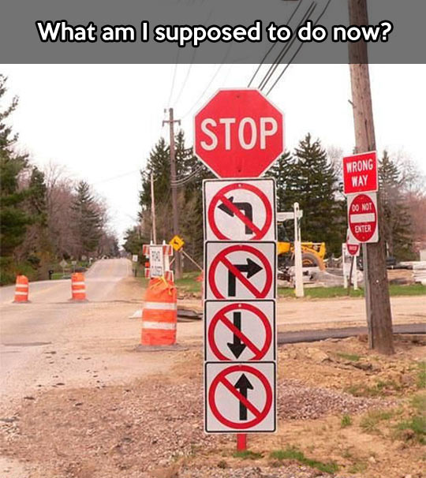
Notes:
PCIT Skills Development and coaching can be considered part of a “non-formal” education – caregivers not in a class on child develoment

Slide 12
Tools for cdi
Family Engagement

Slide 13



Coach Experience = Personal Analogy
Medical
Sports
Cooking
Notes:
Tv show, movie characters, video gameing, etc…
Through intake assessment – can be challenge if intake clinician not the same person for PCIT

Slide 14
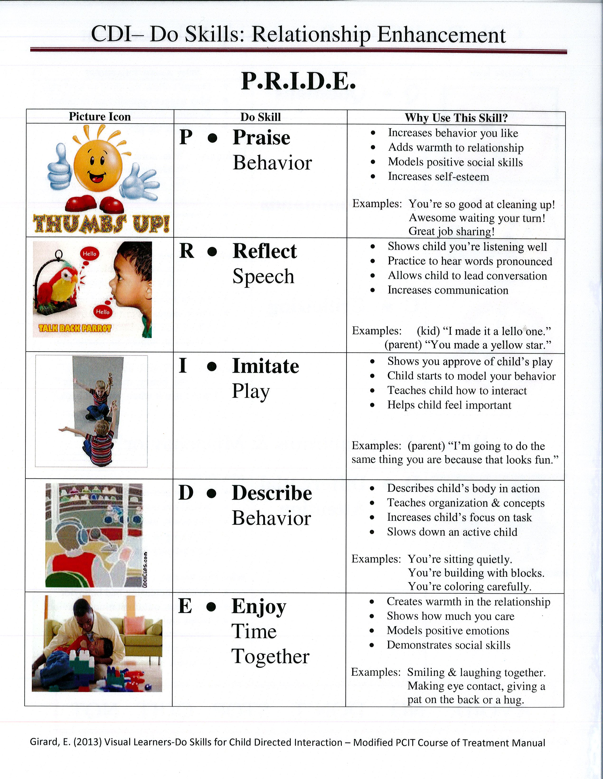
Visual Learners PRIDE

Slide 15
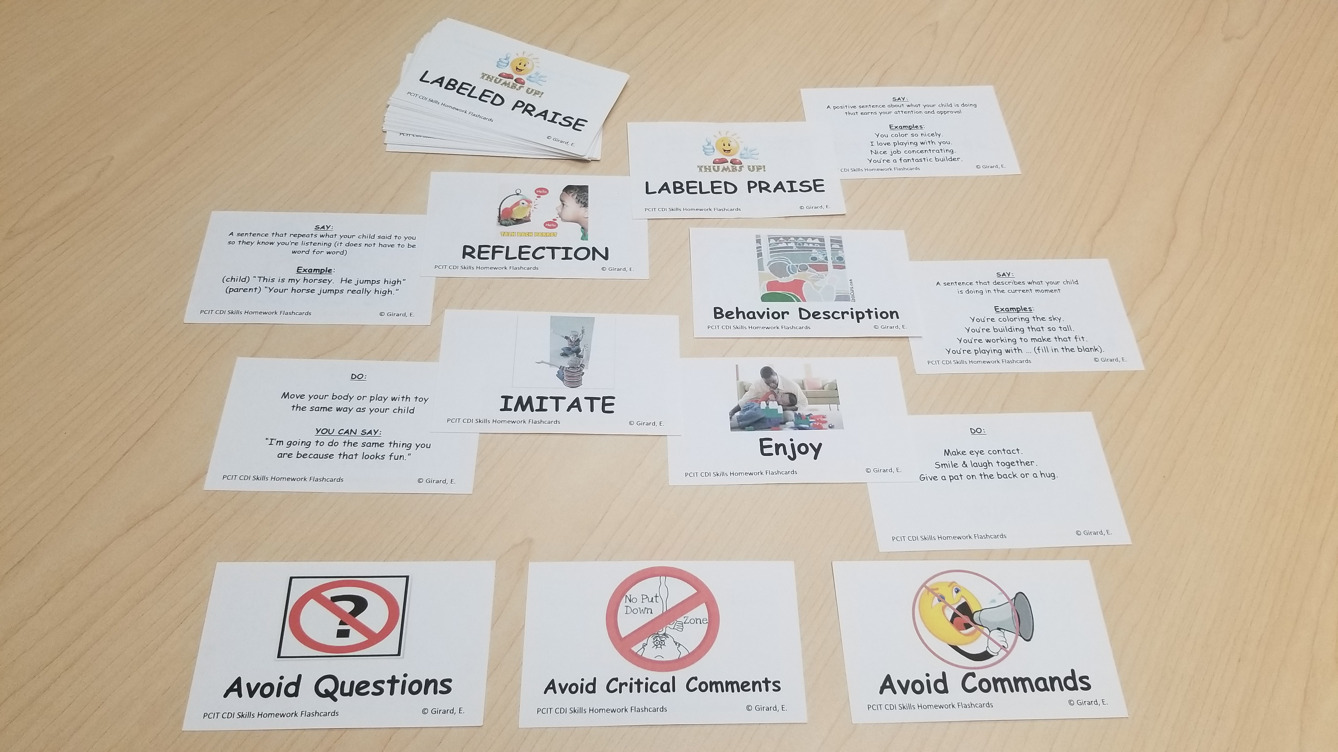
Homework Flashcards
Notes:
Deck of cards with 10 each for mastery, 2 each don’t skills as reminder, shuffle deck and complete in 5 minutes

Slide 16
Positive Opposite HW Focus

Slide 17

How to Improve Readiness
Homework folders
Reminder phone calls or emails
PCIT mobile applications
Audio / Video record 5 minutes of Special Time homework and review at check-in
Homework Sheets
PRIDE Skills
Progress Graphs
Notes:
Is the caregiver aware of which method of teaching works best for them?

Slide 18
Tools for Pdi
Family Engagement

Slide 19
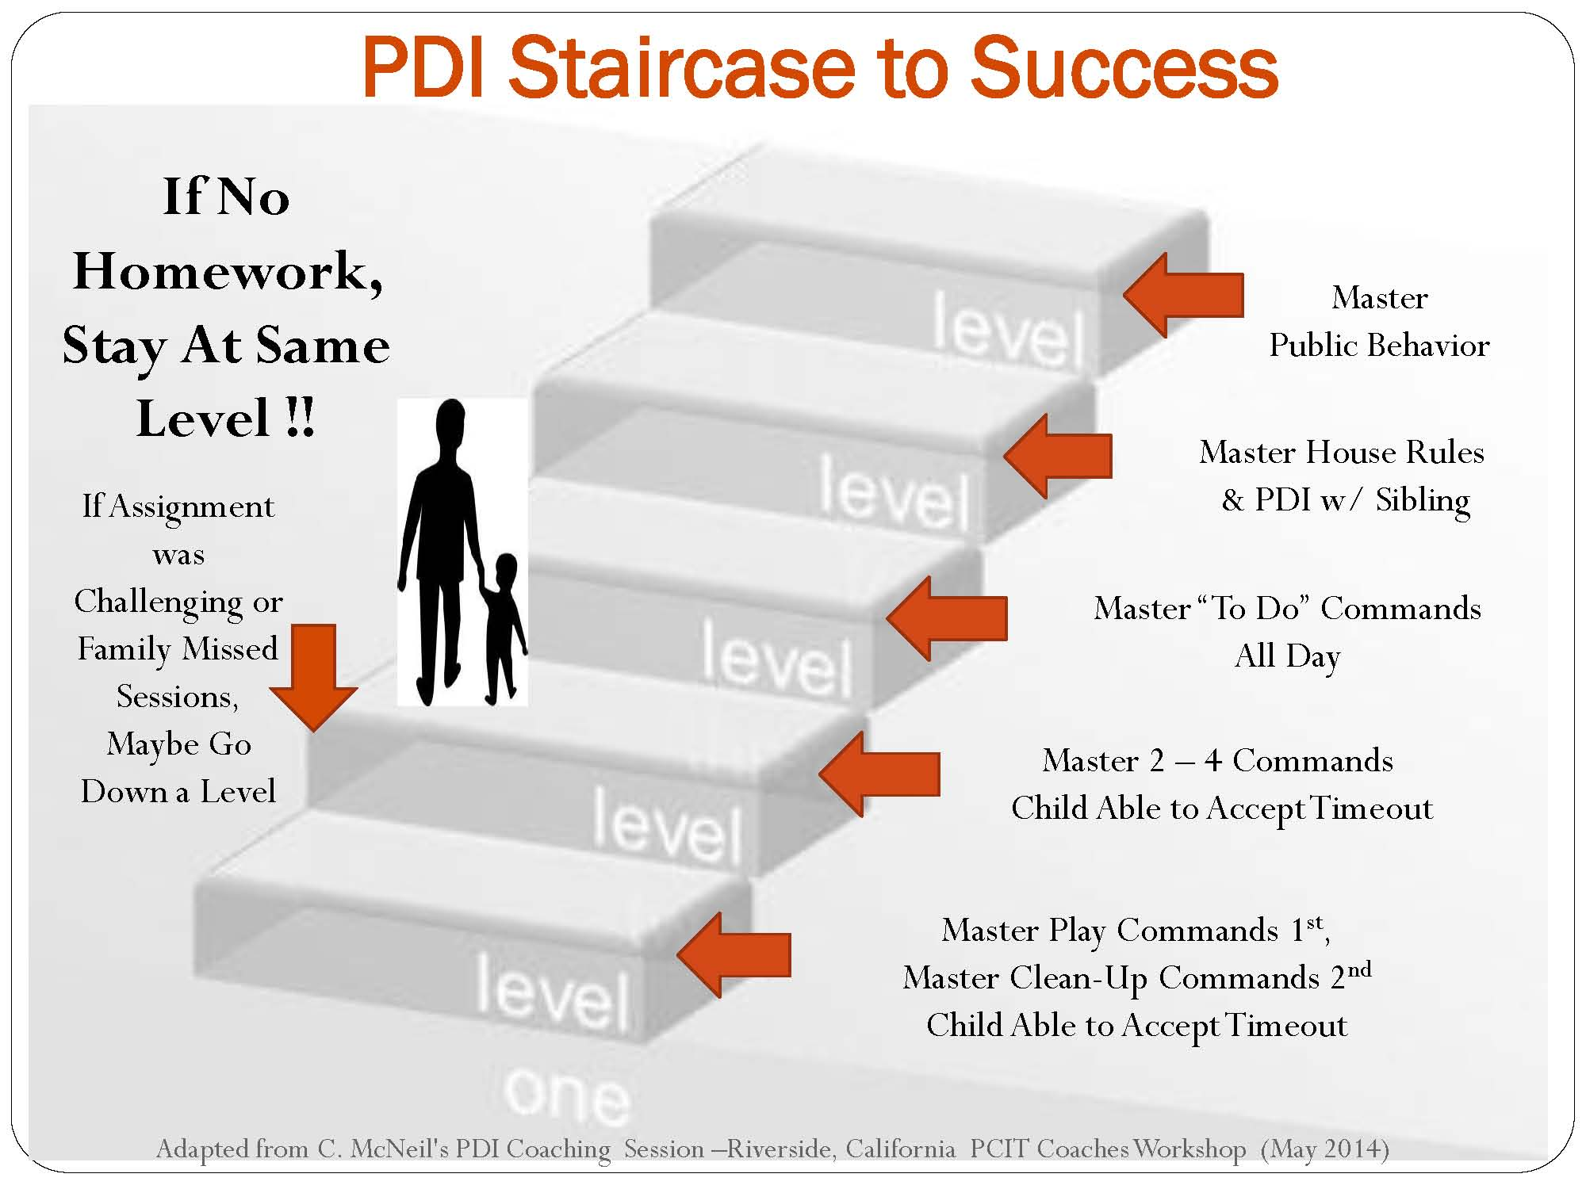
PDI Staircase – Thank you Cheryl

Slide 20
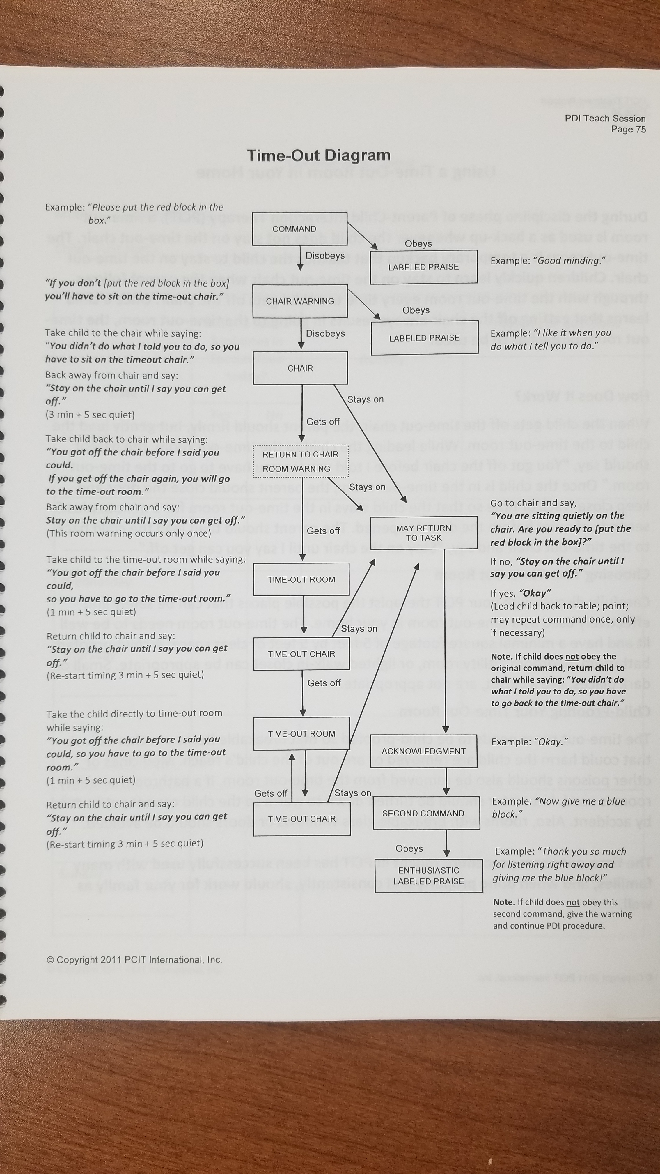
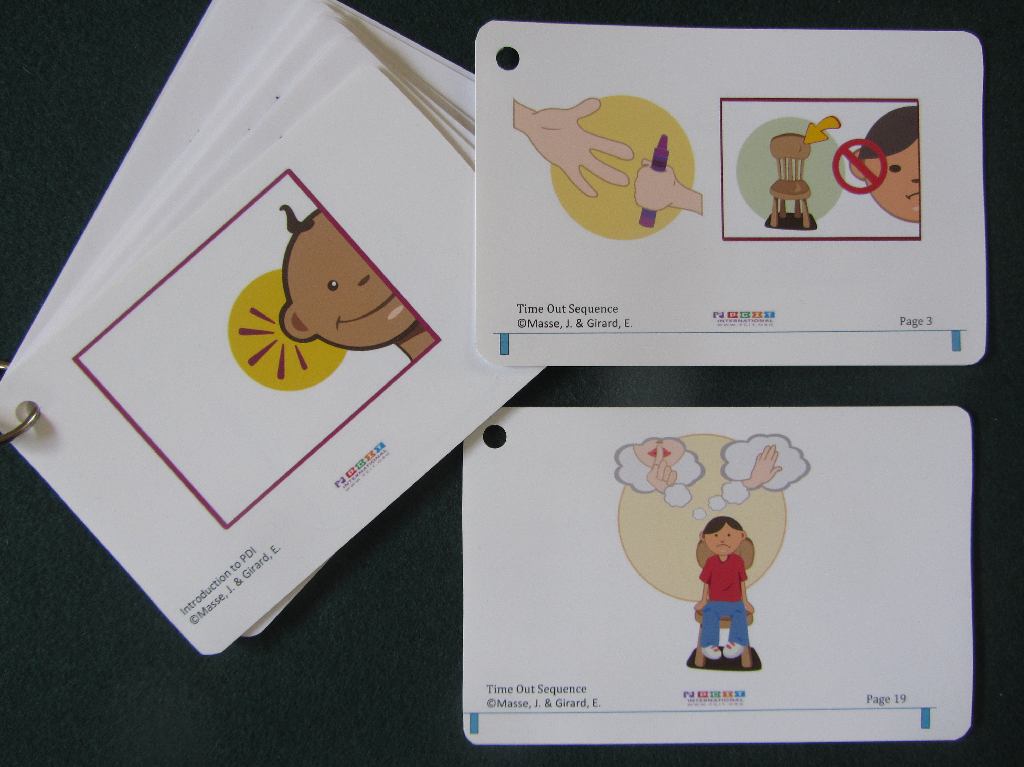
Teaching the Time-Out Method
http://www.pcit.org/store/c4/Flip_Books.html

Slide 21
Creating Effective DC’s
Sentence Stems
Remember Appendix ☺

Slide 22
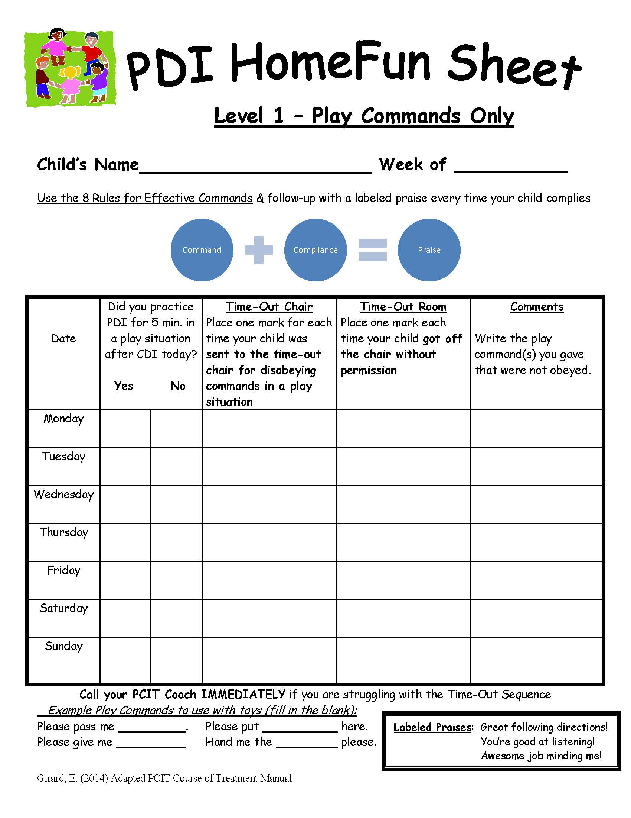

PDI Modified Homework Sheets

Slide 23
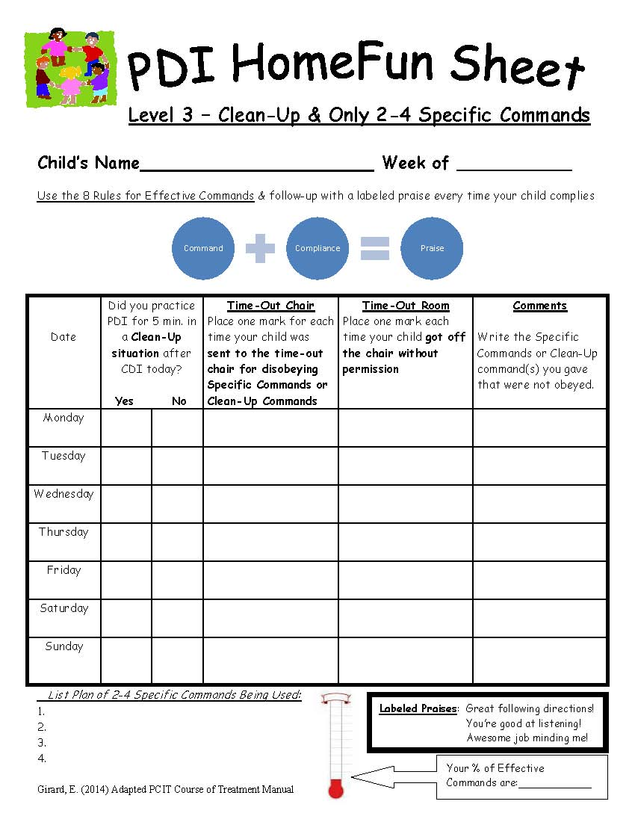
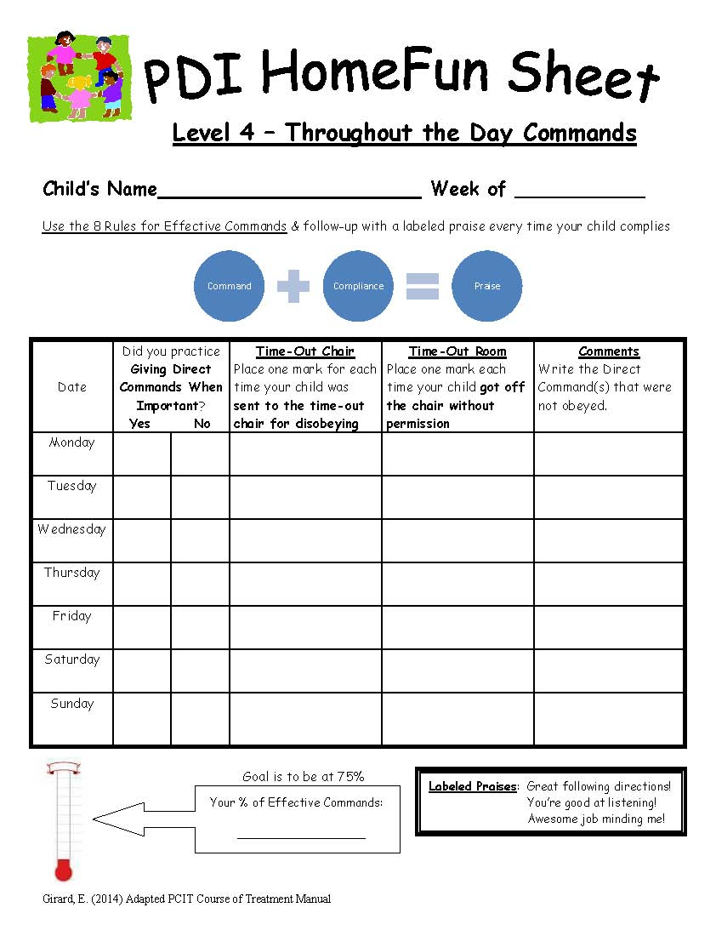
PDI Modified Homework Sheets

Slide 24
Handout: Real Life Commands
Carefully Timed Explanation | Direct Command | Labeled Praise
Time to leave for school. | Put your shoes on please. | Great job getting ready.
Breakfast is over, time for fresh breath. | Please go brush your teeth. | Thanks for following directions quickly.
After snack it’s time for homework. | Please do this page of homework. | You’re smart with schoolwork.
Mom has to speak in private to…. | Please stay in the room. | I’m so proud of you waiting all by yourself.
I am going to use the bathroom. | Please follow me now. | You’re good at listening right away.
Dinner is ready. | Come sit down to eat please. | I love that you are such a good listener.
Time to take turns with the toys. | Please give the toy to …… | Excellent sharing.
After dinner the plates go in the sink. | Please take your plate to the sink. | You’re amazing at cleaning up.
Time to do chores. | Please (fill in one chore). | I love how responsible you are with chores.
The parking lot has lots of cars. | Please hold my hand. | Great work being safe.
This meeting will take a long time. | Please go to the bathroom. | Thank you for following directions.
I have an important phone call. | Please play quietly while I’m on the phone. | Awesome job knowing how to behave when I talk on the phone.

Slide 25
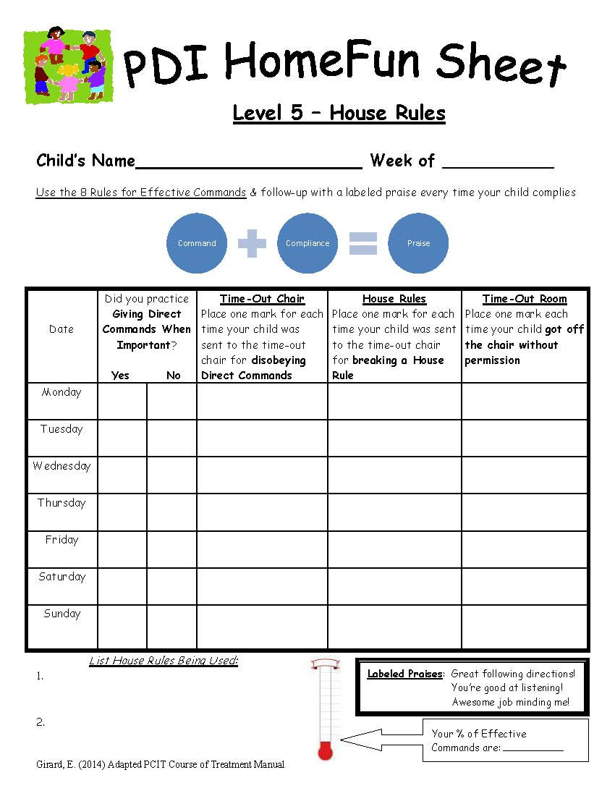
PDI Modified Homework Sheets

Slide 26
Coaching the Time-Out
T.O. occurs only in home setting, not clinic
  Schedule a PDI home visit session?
  Video T.O. sequence at home?
  Is standard CDI 5 minutes a day occurring?
T.O. occurs only in clinic, not home
  Does parent implement T.O. at home?
  Is follow through only with clinician coaching?
  Do other caregivers agree with T.O. sequence?

Slide 27
House Rules
Do they apply to only the “PCIT” child?
Is there consistency with implementation?
How are expectations known to all?

Slide 28
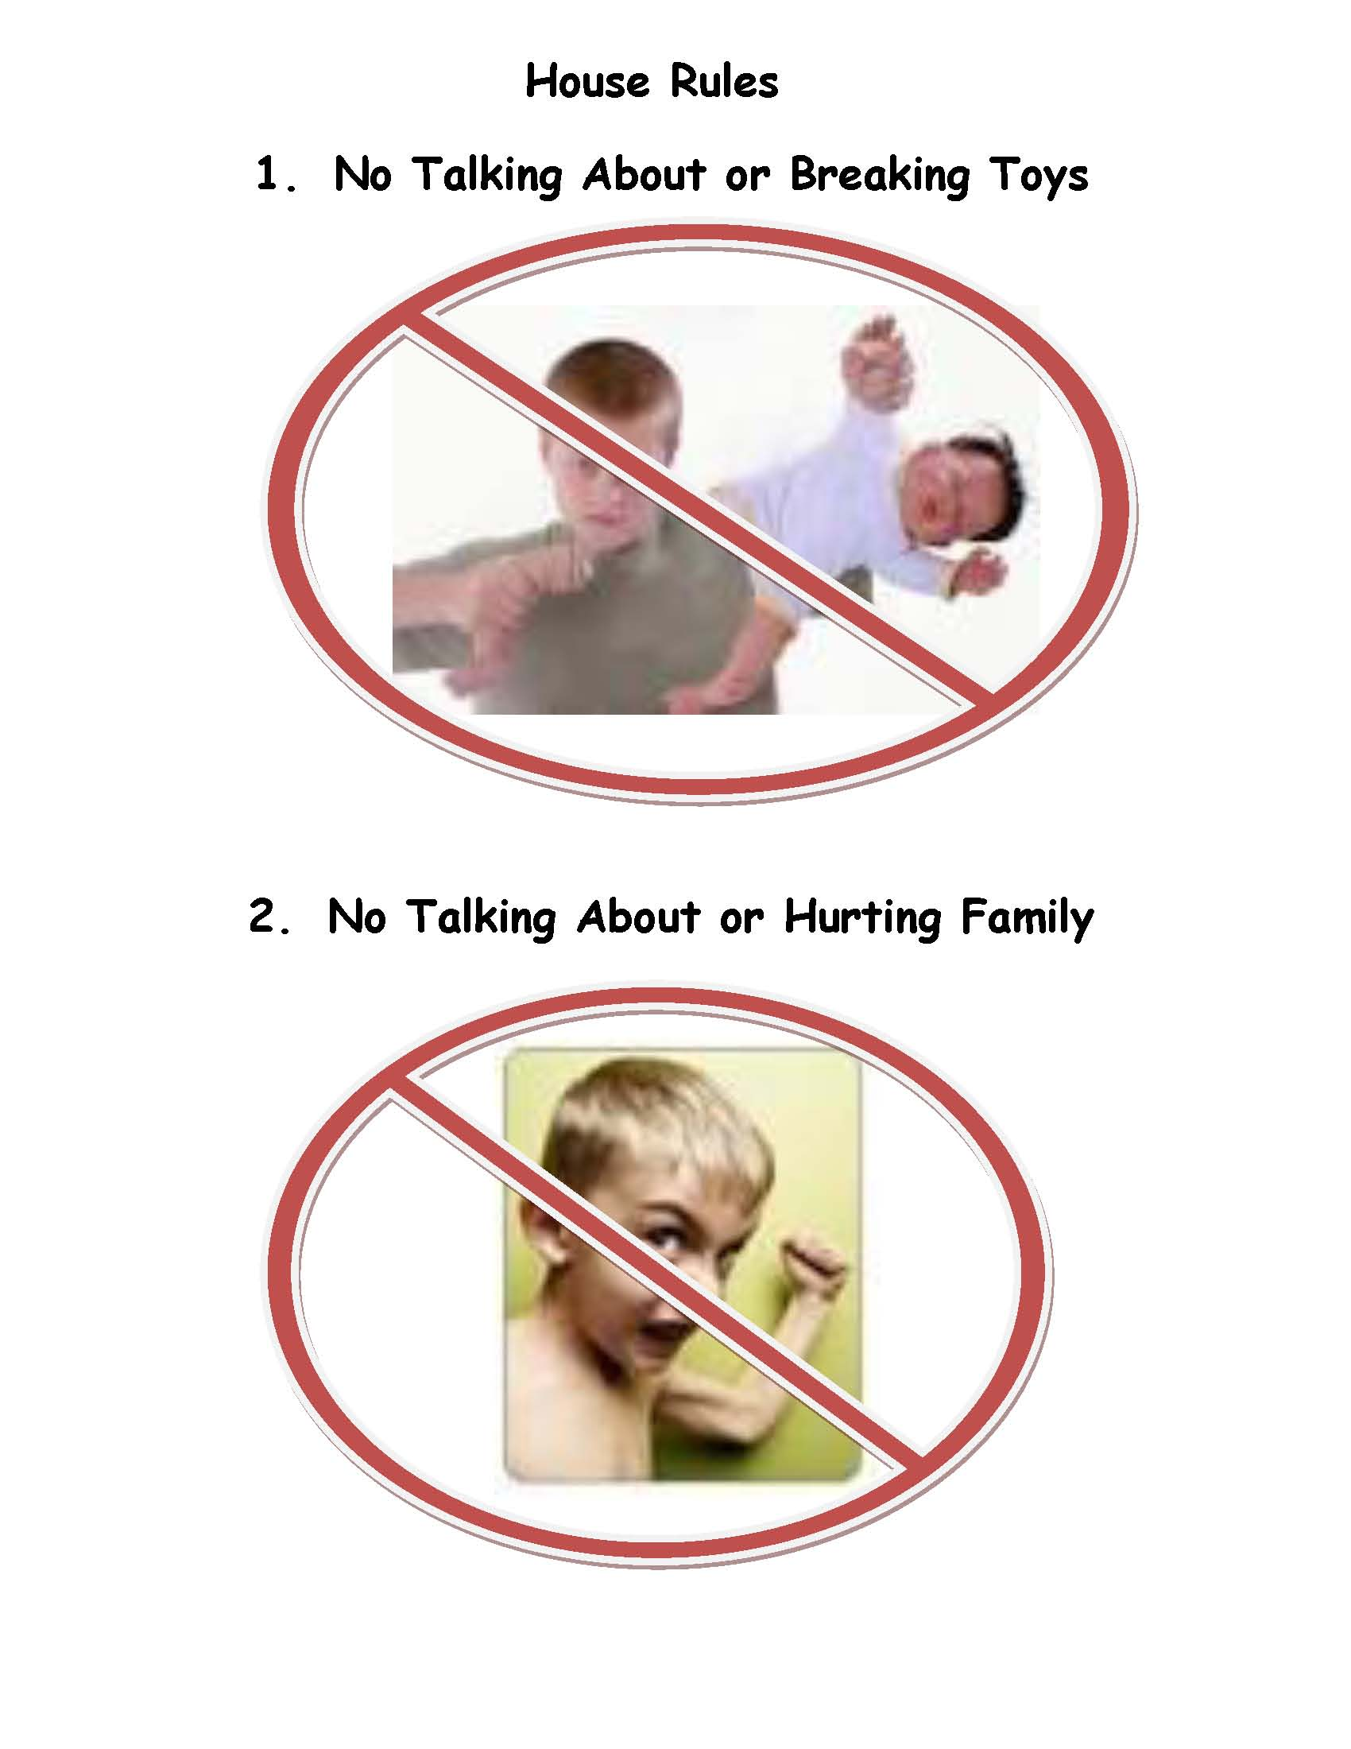
House Rules
Notes:
Do you use pictures with words?

Slide 29
As a PCIT Coach…
We can use the teaching tools shared to improve Adult Learning
Image Source:
http://leanlearning.wikispaces.com/instructional_design
Notes:
List various obstacles that interfere with each learning category.

Slide 30
Agenda & Goals
Improve clinical knowledge related to adult learning theory
Review and provide teaching tools during CDI to improve caregiver skill acquisition
Review and provide teaching tools during PDI to improve caregiver skill acquisition

Slide 31

Wrap Up and Questions

