Slide 1
Parent child interaction therapy 2nd half of Pcit training by Kami Guzman, LMHC

Slide 2
Code the Coach
Praises for Positive parenting
Impact of positive parenting
Observation of parents positive impact on child
Delight in child or child’s interactions
Supportive/empathic statements acknowledging caregivers struggles or child’s difficulties
Misc. positive

Slide 3
10 Rules To Effective Commands
Positively State the command
Reason before command and or after compliance
Age appropriate command
Calm and courteous command
Tell, don’t ask
Individual command
Clear command
Enough commands

Slide 4
Timeout Protocol
Handout
Role pLay

Slide 5
Teaching the parent and child
Its imperative the commands are direct
Don’t have the parent do it at home the first time
Don’t let the parent use negative words (naughty chair, bad, and ect)
Use a stuffed toy to show the child how play will change
Have parent teach the child
Let the child participate in the teaching
keep it positive

Slide 6
Use fun language
Lets play the listening game
Take your ears out of your pocket
Listening is fun
Put your listening ears on

Slide 8
Time for internal reflection
Discuss underlying feelings of each participant
Parent
Child
Therapist

Slide 9
Being With
Sad
Anger
Fear
Joy
Shame
Curiosity

Slide 10
Rollin’ Out commands

Slide 11
Play commands
“Please hand me the Lego”
“Please hand me the car”
“Please put the horse in the fence”
“Please put the green lego on the red lego”

Slide 12
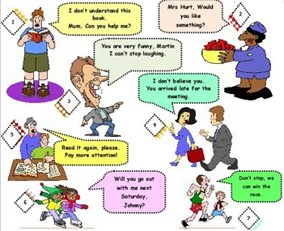
Other commands
Transition commands
Go with the flow commands
Real life commands
Clean up commands
Makes no sense commands
Public commands
Commands with siblings present

Slide 13
Homework
USE therapeutic judgement*******
Discuss the commands that will be given at home
Give commands during special play first
Then 2-4 real commands at home
Real commands during the day

Slide 14
Siblings?????????
Which kid do we do PCIT with?
Check in on All kids in the home

Slide 15
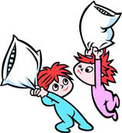
Sibling Session
Can be several sessions
Can be a horrible session
Overwhelming
Many timeout chairs
Part of the foundation

Slide 16
Turn Taking
Sharing
Getting along well with others
Alternatives to tattling
Recognizing positive qualities of siblings
Asking before taking toys
Using polite manners
The “no hurting” Rules
Problem Solving
Keeping hands and feet to oneself

Slide 17
Cooperation game
Create it as a family
Moving forward
Moving backward
Rewards

Slide 18
Coaching
Babysitters
Older siblings
Siblings without disruptive behaviors
Grandparents
any “interactionary” person

Slide 19
House rules
One active house rule at a time-no more than two
What are good house rules
There shouldn’t be a need for many rules
Practice the house rule
Automatic time out
Create, laminate, post--together

Slide 20
House RUles
100% consistency
The slot machine effect

Slide 21
teamwork
Include the child in the planning of house rules and cooperation game
Discuss the role of each family member
Coach parents in working together
Explore triggers in the family

Slide 22
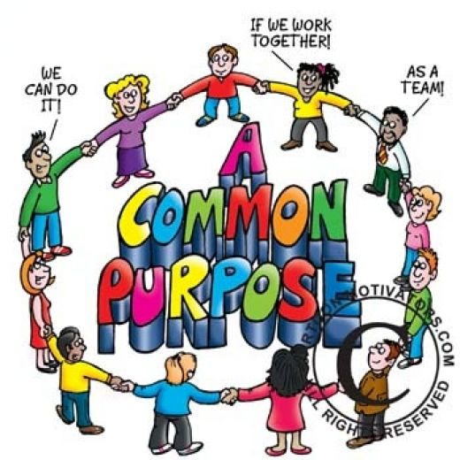
Family team building exercises
Cooperation game
Love languages
Inside out characters
Love Cups
The Snoodle’s Tale
Genogram with boundaries
Blindfold game
Christmas Bulbs
Hands excercise

Slide 23
Public behavior
Start easy and then build to harder locations
Clear Expectations
Start with one child and build to all siblings
Timeout rag
Lots of labeled praises

